Slide 1

KIRCHHOFF CURRENT LAW
ONE OF THE FUNDAMENTAL CONSERVATION PRINCIPLES
IN ELECTRICAL ENGINEERING
“CHARGE CANNOT BE CREATED NOR DESTROYED”

Slide 2
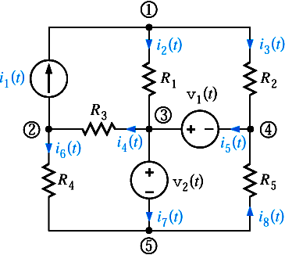

NODES, BRANCHES, LOOPS
A NODE CONNECTS SEVERAL COMPONENTS.
BUT IT DOES NOT HOLD ANY CHARGE.
TOTAL CURRENT FLOWING INTO THE NODE
MUST BE EQUAL TO TOTAL CURRENT OUT
OF THE NODE
(A CONSERVATION OF CHARGE PRINCIPLE)
NODE: point where two, or more, elements
are joined (e.g., big node 1)
LOOP: A closed path that never goes
twice over a node (e.g., the blue line)
NODE
The red path is NOT a loop
BRANCH: Component connected between two
nodes (e.g., component R4)

Slide 3
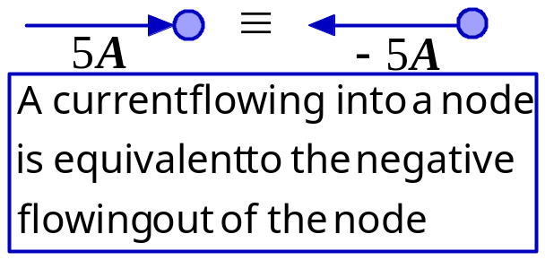
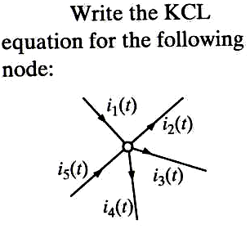

KIRCHHOFF CURRENT LAW (KCL)
SUM OF CURRENTS FLOWING INTO A NODE IS
EQUAL TO SUM OF CURRENTS FLOWING OUT OF
THE NODE
ALGEBRAIC SUM OF CURRENT (FLOWING) OUT OF
A NODE IS ZERO
ALGEBRAIC SUM OF CURRENTS FLOWING INTO A
NODE IS ZERO

Slide 4
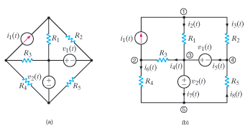
A node is a point of connection of two or more circuit elements.
It may be stretched out or compressed for visual purposes…
But it is still a node

Slide 5
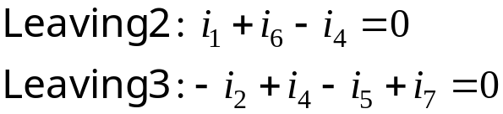
A GENERALIZED NODE IS ANY PART OF A
CIRCUIT WHERE THERE IS NO ACCUMULATION
OF CHARGE
... OR WE CAN MAKE SUPERNODES BY
AGGREGATING NODES
INTERPRETATION: SUM OF CURRENTS LEAVING
NODES 2&3 IS ZERO
VISUALIZATION: WE CAN ENCLOSE NODES 2&3
INSIDE A SURFACE THAT IS VIEWED AS A
GENERALIZED NODE (OR SUPERNODE)

Slide 6
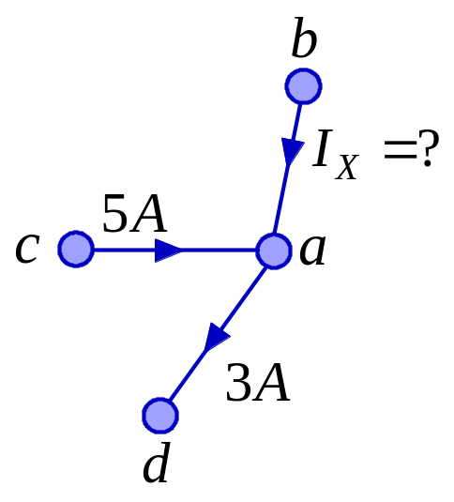




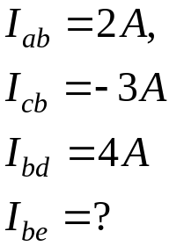
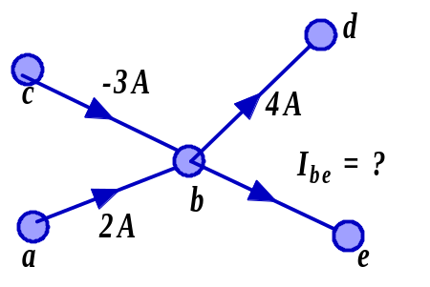


PROBLEM SOLVING HINT: KCL CAN BE USED
TO FIND A MISSING CURRENT
WRITE ALL KCL EQUATIONS
SUM OF CURRENTS INTO
NODE IS ZERO
Which way are charges
flowing on branch a-b?
...AND PRACTICE NOTATION CONVENTION AT
THE SAME TIME...
NODES: a,b,c,d,e
BRANCHES: a-b,c-b,d-b,e-b
THE FIFTH EQUATION IS THE SUM OF THE
FIRST FOUR... IT IS REDUNDANT!!!

Slide 7
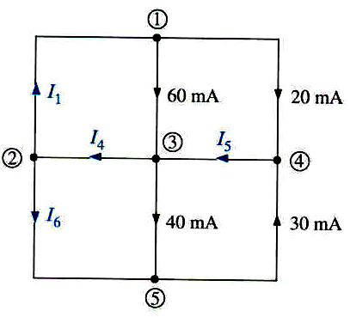




FIND MISSING CURRENTS
KCL DEPENDS ONLY ON THE INTERCONNECTION.
THE TYPE OF COMPONENT IS IRRELEVANT
KCL DEPENDS ONLY ON THE TOPOLOGY OF THE CIRCUIT

Slide 8
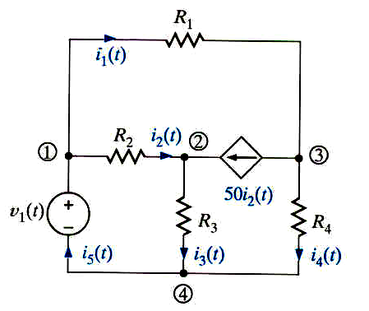
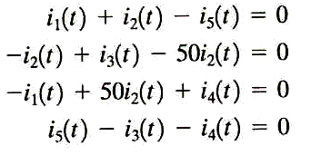
WRITE KCL EQUATIONS FOR THIS CIRCUIT
THE LAST EQUATION IS AGAIN LINEARLY
DEPENDENT OF THE PREVIOUS THREE
THE PRESENCE OF A DEPENDENT SOURCE
DOES NOT AFFECT APPLICATION OF KCL
KCL DEPENDS ONLY ON THE TOPOLOGY

Slide 9

Here we illustrate the use
of a more general idea of
node. The shaded surface
encloses a section of the
circuit and can be considered
as a BIG node
THE CURRENT I5 BECOMES INTERNAL TO THE
NODE AND IT IS NOT NEEDED!!!

Slide 10


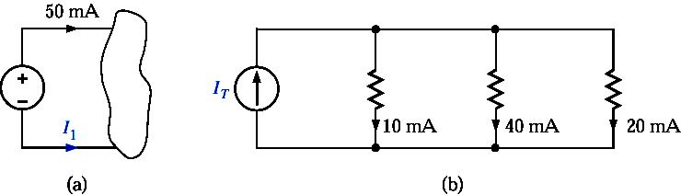





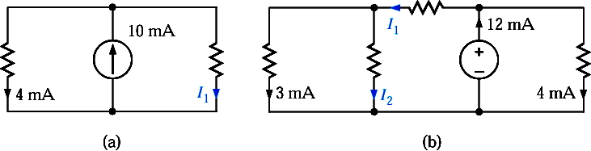


Slide 11

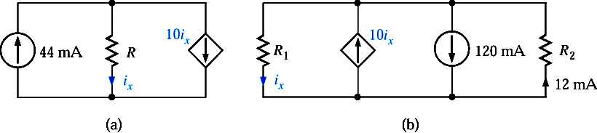
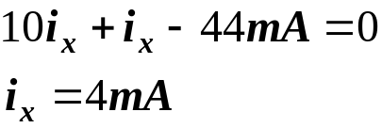



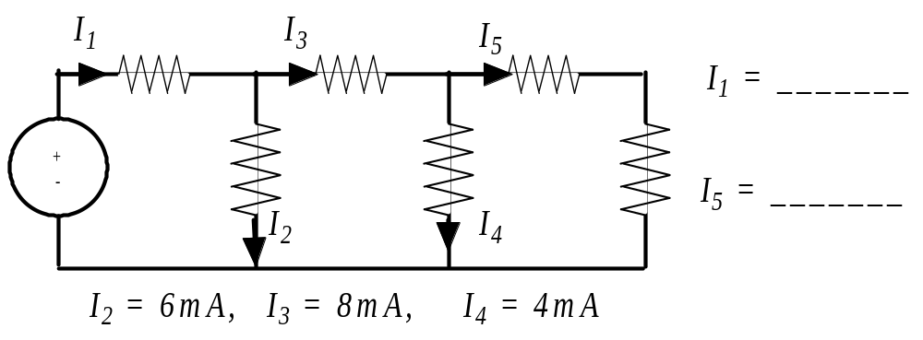



Slide 12
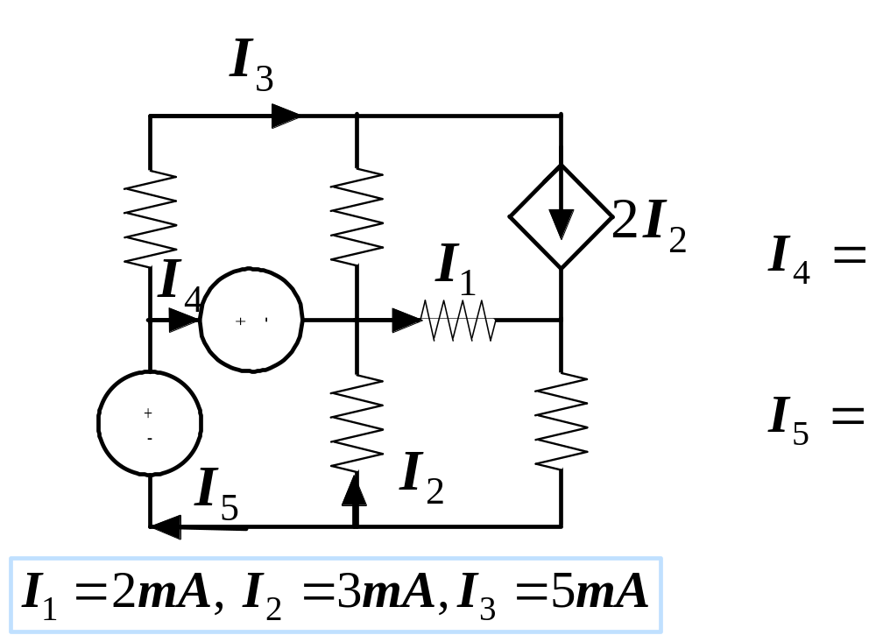






DETERMINE THE CURRENTS INDICATED
THE PLAN
MARK ALL THE KNOWN CURRENTS
FIND NODES WHERE ALL BUT ONE CURRENT
ARE KNOWN

Slide 13
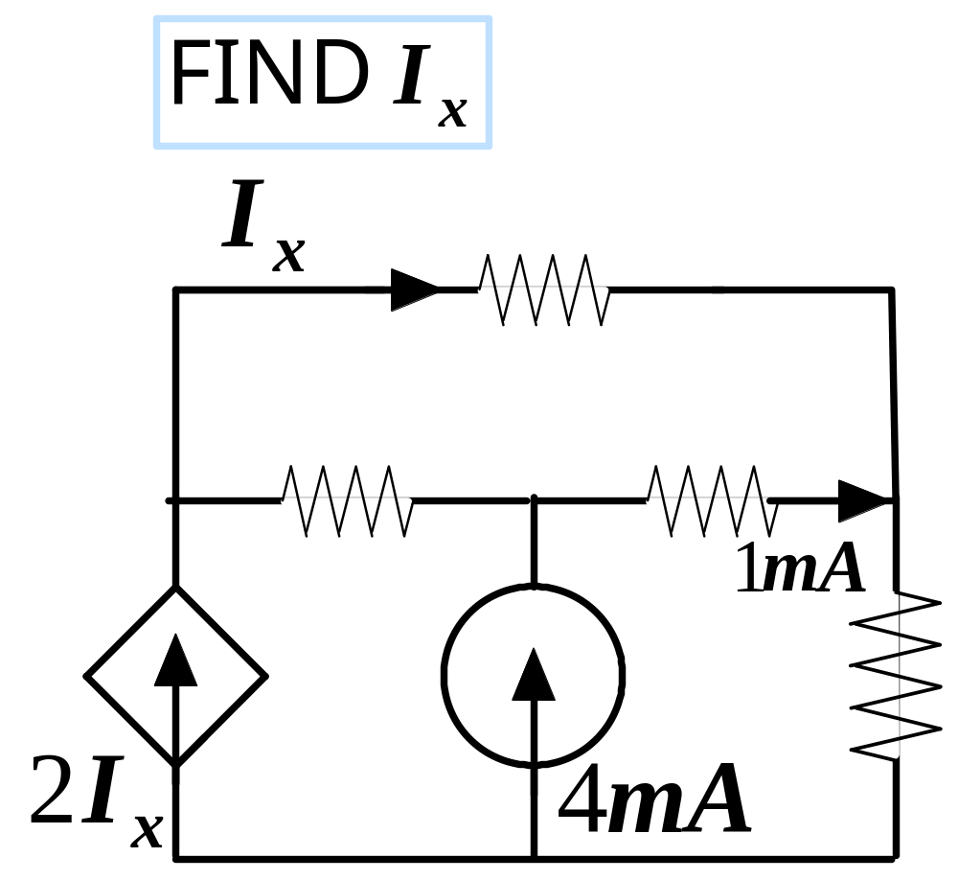



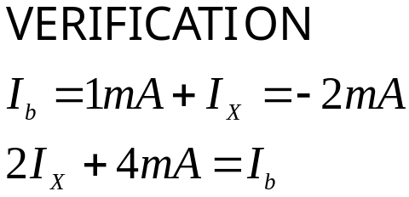



Slide 14
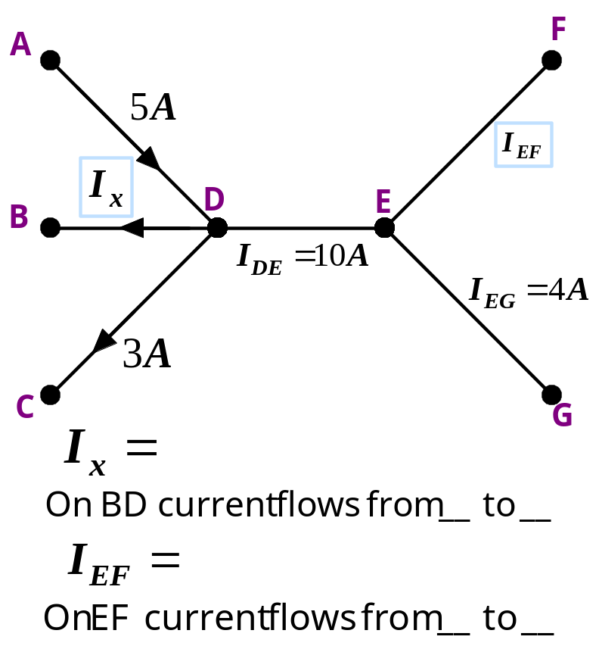



This question tests KCL and
convention to denote currents
Use sum of currents leaving node = 0
-8A
B
D
6A
E
F
KCL

Slide 15
KIRCHHOFF VOLTAGE LAW
ONE OF THE FUNDAMENTAL CONSERVATION LAWS
IN ELECTRICAL ENGINERING
THIS IS A CONSERVATION OF ENERGY PRINCIPLE
“ENERGY CANNOT BE CREATE NOR DESTROYED”

Slide 16
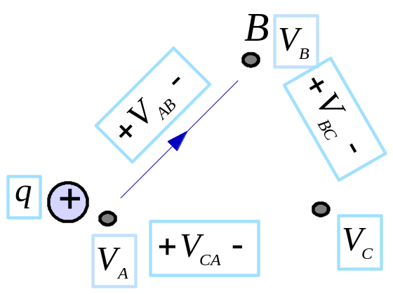


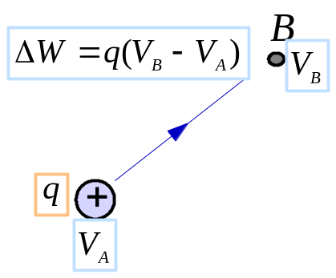

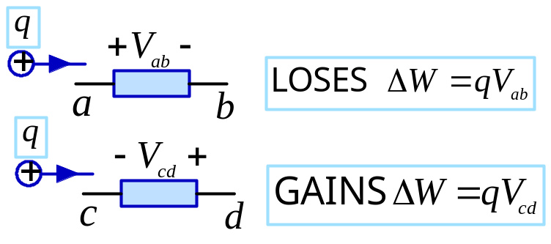

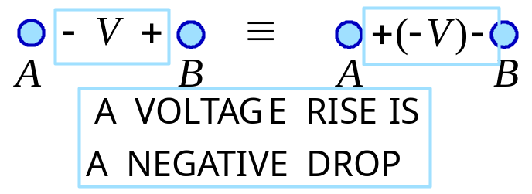
KIRCHHOFF VOLTAGE LAW (KVL)
A “THOUGHT EXPERIMENT”
KVL IS A CONSERVATION OF ENERGY PRINCIPLE
A POSITIVE CHARGE GAINS ENERGY AS IT MOVES
TO A POINT WITH HIGHER VOLTAGE AND RELEASES
ENERGY IF IT MOVES TO A POINT WITH LOWER
VOLTAGE
IF THE CHARGE COMES BACK TO THE SAME
INITIAL POINT THE NET ENERGY GAIN
MUST BE ZERO (Conservative network)
OTHERWISE THE CHARGE COULD END UP WITH
INFINITE ENERGY, OR SUPPLY AN INFINITE
AMOUNT OF ENERGY
KVL: THE ALGEBRAIC SUM OF VOLTAGE
DROPS AROUND ANY LOOP MUST BE ZERO

Slide 17
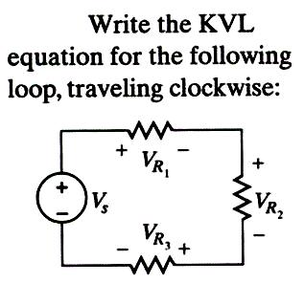
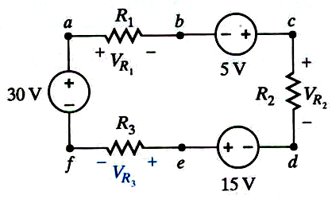



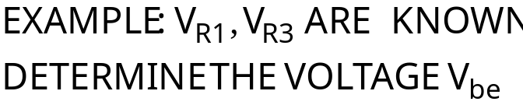



PROBLEM SOLVING TIP: KVL IS USEFUL
TO DETERMINE A VOLTAGE - FIND A LOOP
INCLUDING THE UNKNOWN VOLTAGE
THE LOOP DOES NOT HAVE TO BE PHYSICAL
LOOP abcdefa

Slide 18
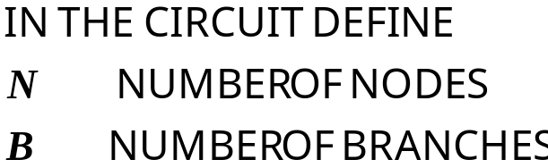
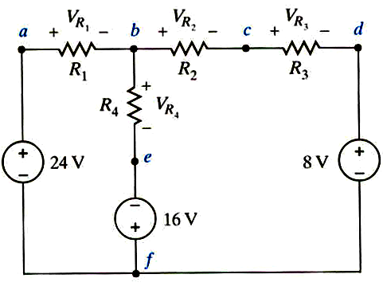
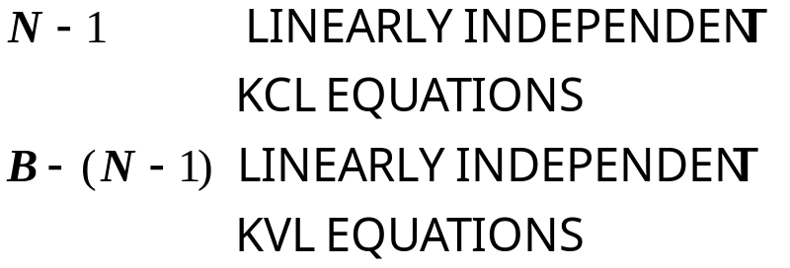



BACKGROUND: WHEN DISCUSSING KCL WE SAW
THAT NOT ALL POSSIBLE KCL EQUATIONS
ARE INDEPENDENT. WE SHALL SEE THAT THE
SAME SITUATION ARISES WHEN USING KVL
A SNEAK PREVIEW ON THE NUMBER OF
LINEARLY INDEPENDENT EQUATIONS
EXAMPLE: FOR THE CIRCUIT SHOWN WE HAVE
N = 6, B = 7.
HENCE THERE ARE ONLY TWO INDEPENDENT
KVL EQUATIONS
THE THIRD EQUATION IS THE SUM OF THE
OTHER TWO!!

Slide 19

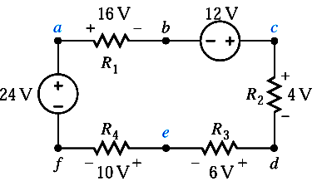
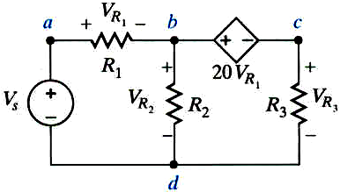





DEPENDENT SOURCES ARE HANDLED WITH THE
SAME EASE
GIVEN THE CHOICE USE THE SIMPLEST LOOP

Slide 20
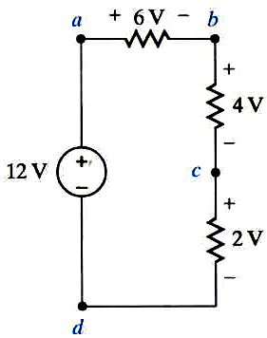
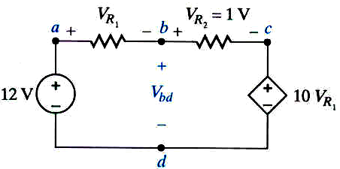
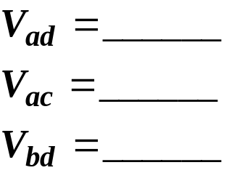








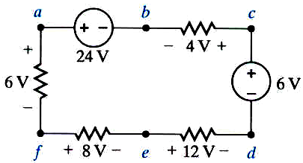

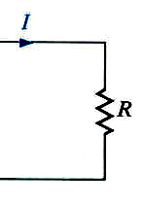

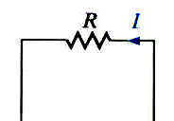


DEPENDENT SOURCES ARE NOT REALLY
DIFFICULT TO ANALYZE
REMINDER: IN A RESISTOR THE VOLTAGE AND
CURRENT DIRECTIONS MUST SATISFY THE
PASSIVE SIGN CONVENTION

Slide 21
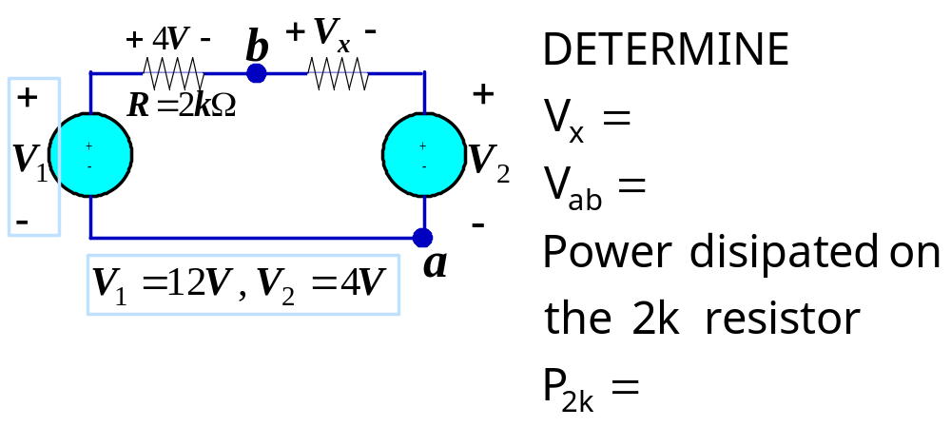
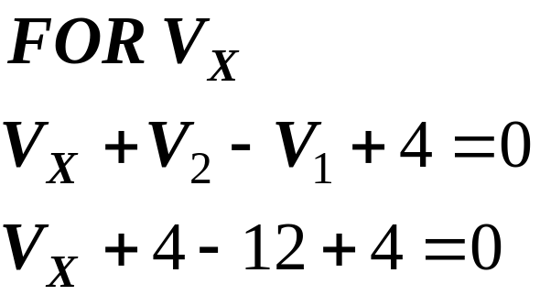
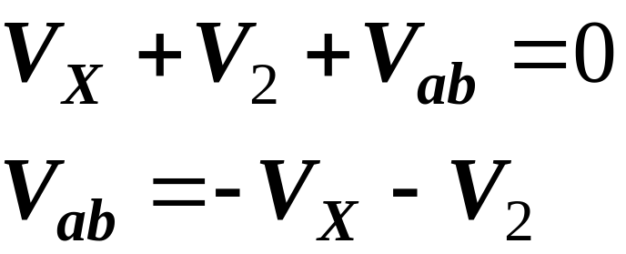
SAMPLE PROBLEM
4V
-8V
Remember
past topics
We need to find a closed path where only one voltage is unknown

Slide 22
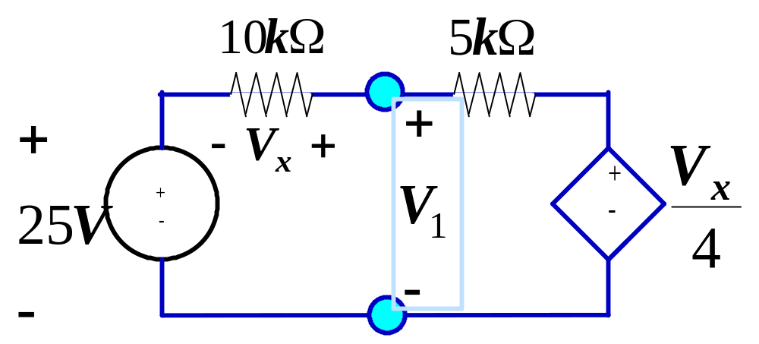
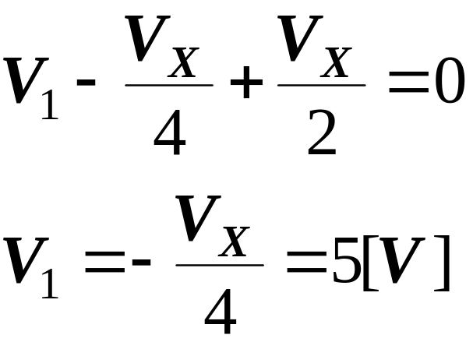
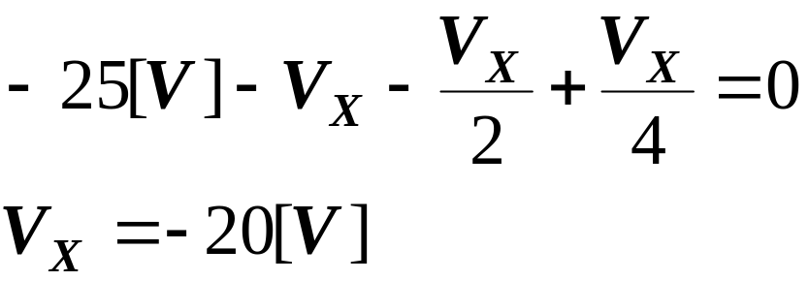
There are no loops with only
one unknown!!!
- Vx/2 +
The current through the 5k and 10k
resistors is the same. Hence the
voltage drop across the 5k is one half
of the drop across the 10k!!!

